Slide 1
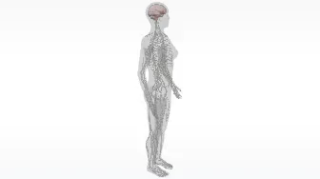
Neurons
AEPSY Year 11 ATAR Psychology

Slide 2
Review
Responsible for transmission of impulses to muscles…
“Rest and digest” component of the autonomic peripheral nervous system…
Somatic motor effect…
Contains vesicles full of neurotransmitters…
Part of the neuron that embeds in sensory receptors…

Slide 3
True or false?
Soma contain the nucleus of the neuron.
Interneurons make up the PNS.
Impulses move from dendrites to axon terminals.
Nerves touch each other.
Nerve transmissions are chemical and synpase transmissions are electrical.
The myelin sheath slows down nerve transmission.
Each neuron contains up to 10 axon terminals.
Interneurons are also called unipolar neurons.

Slide 4
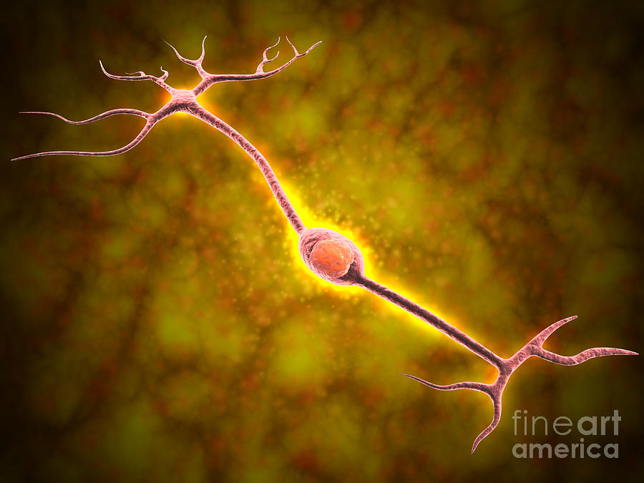
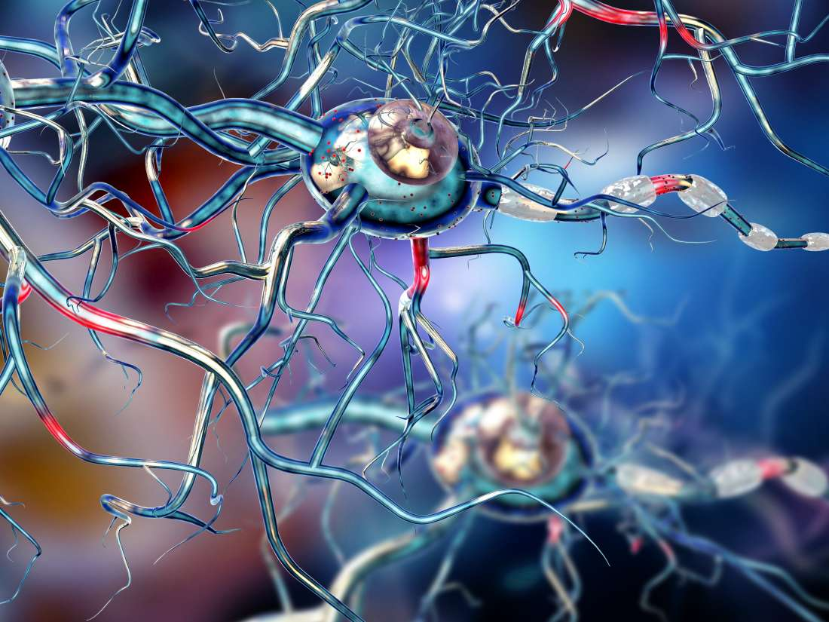
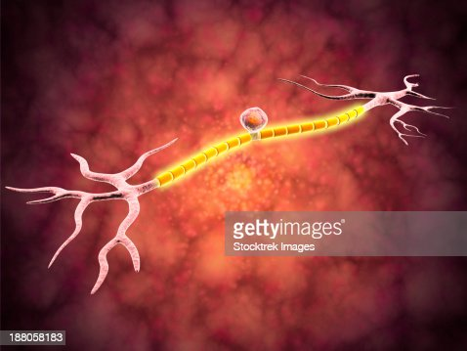
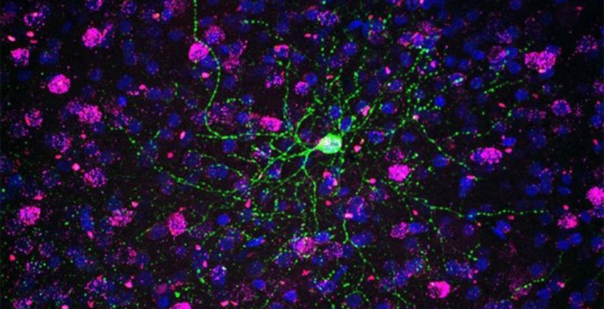
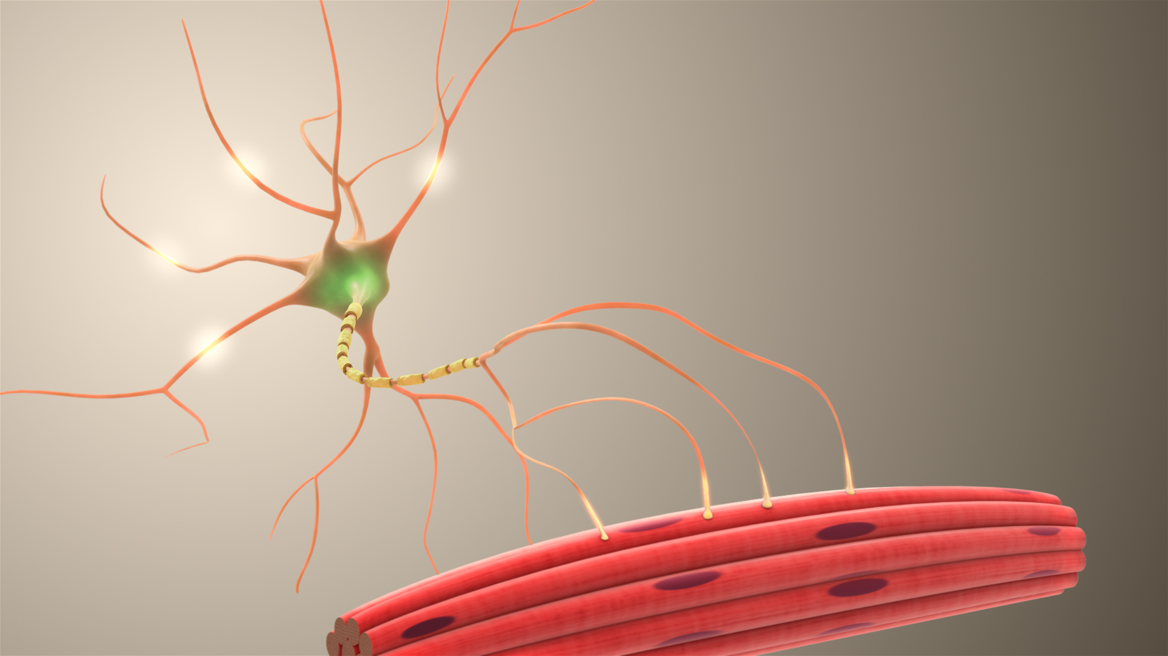
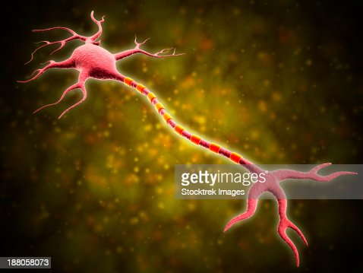
Which type of neuron?

Slide 5
Learning Intentions
location, structure and function of the brain
hindbrain – medulla, cerebellum
midbrain – reticular formation
forebrain – hypothalamus, thalamus, cerebral cortex
left and right hemispheres – contralateral control of the body
corpus callosum

Slide 6
Success Criteria
Label the parts of the brain on an anatomical model
Classify parts of the brain as hind, mid or forebrain
Briefly describe the function of each area of the brain.
Explain the role of the corpus callosum

Slide 7
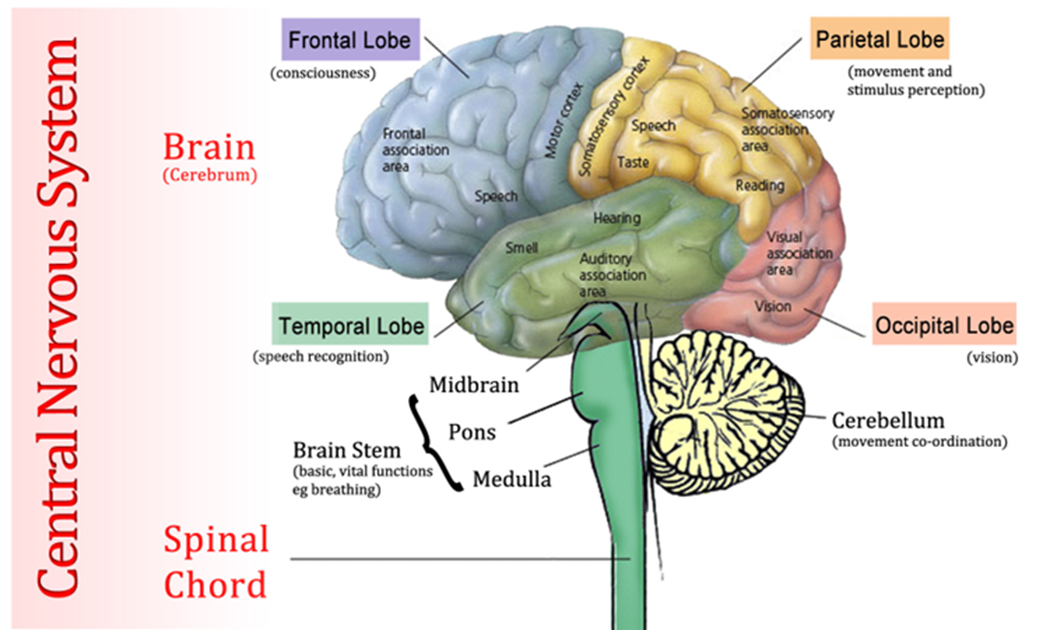

Slide 8
The brain and spinal cord
The brain is one of the largest and most complex organs in the human body.
It is made up of more than 100 billion nerves that communicate in trillions of connections called synapses.

Slide 9
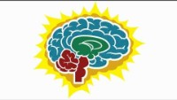

Slide 10
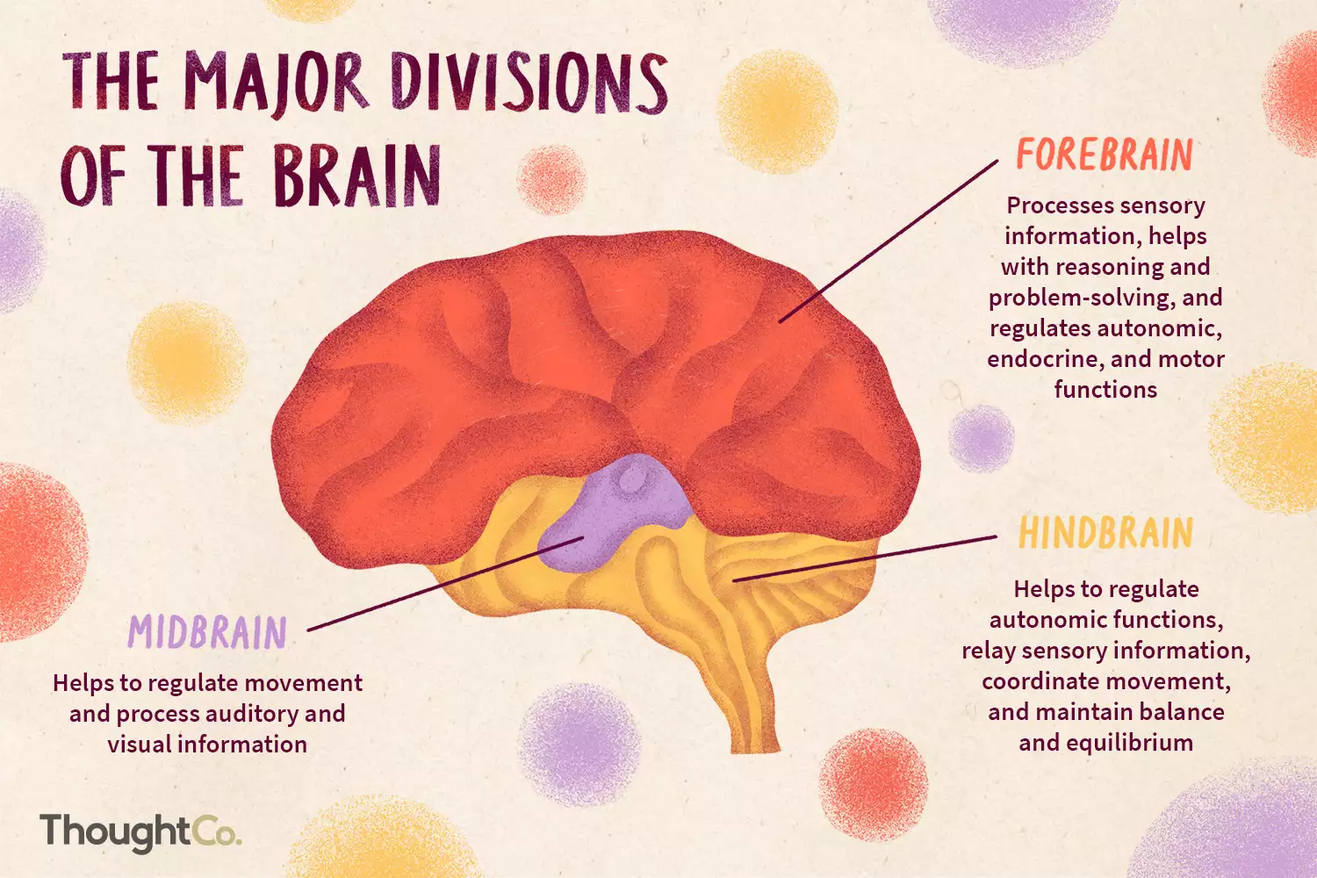

Slide 11
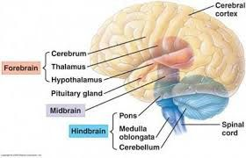
Areas of the brain

Slide 12
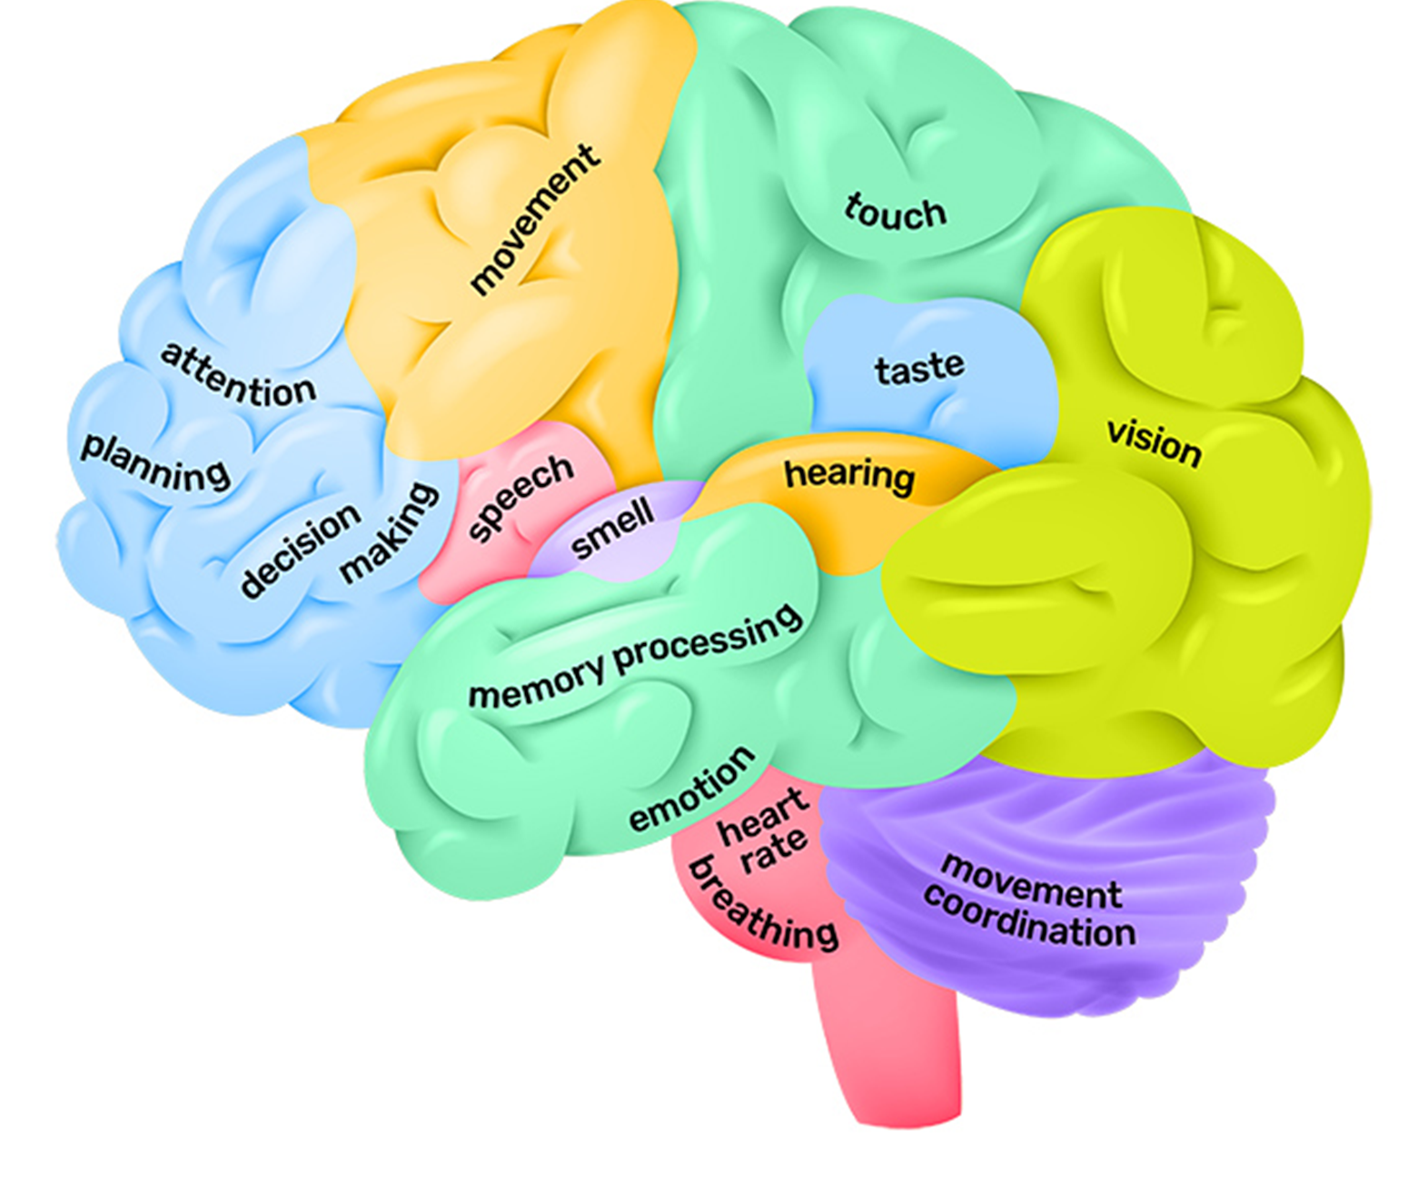

Slide 13
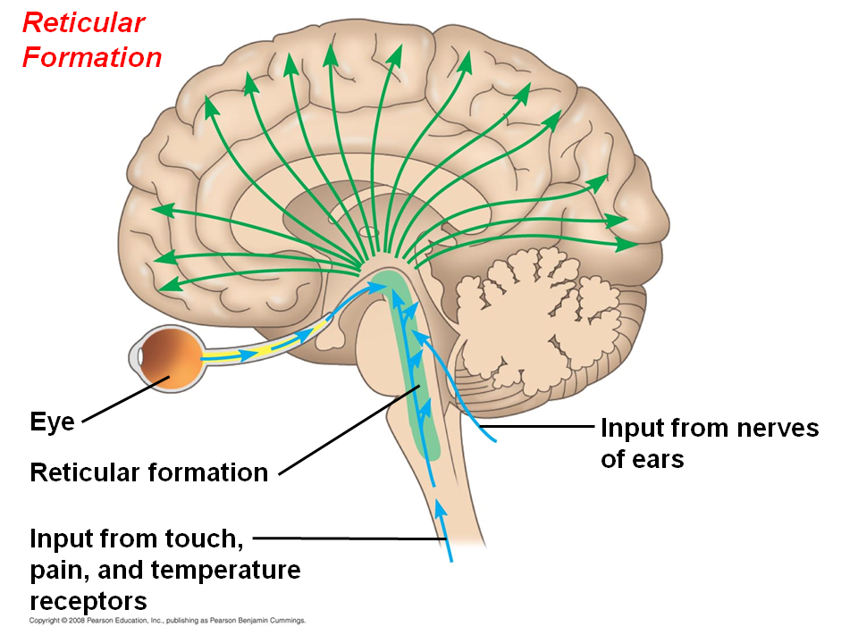

Slide 14
Hemispheres of the brain
The left hemisphere controls the right half of the body, and the right hemisphere controls the left half of the body.
Some functions suggest hemispheric dominance
The left hemisphere -associations in memory, selective attention, and positive emotions.
The right hemisphere - pitch perception, arousal, and negative emotions

Slide 15
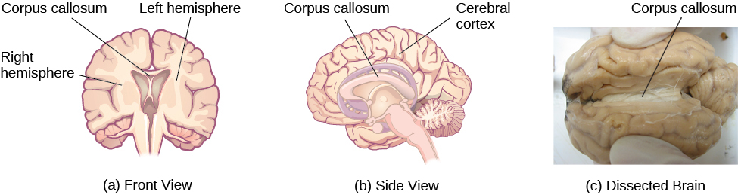
Hemispheres of the brain

Slide 16
Success Criteria
Label the parts of the brain on an anatomical model
Classify parts of the brain as hind, mid or forebrain
Briefly describe the function of each area of the brain.
Explain the role of the corpus callosum

